Slide 1
You Pick ONE!
We are almost done with the basics! Time to learn something more interesting!

Slide 2
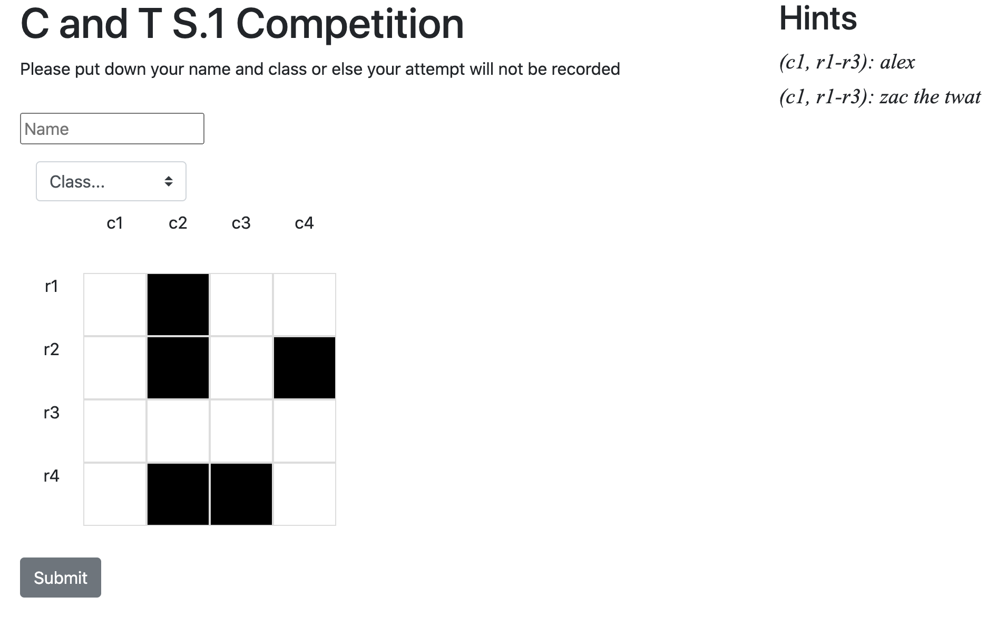
Small web games

Slide 3
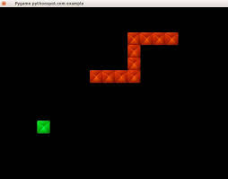
Python Games

Slide 4
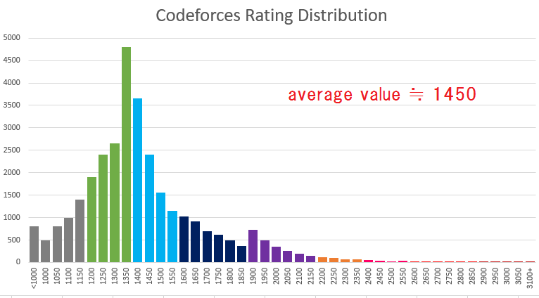
Competitive Programming (Math/Programming)

Slide 5
Python-List

Slide 6
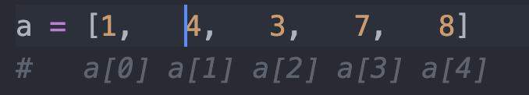
List Structure
a[0] = 1
a[1] = 4
a[2] = 3
a[3] = 7
a[4] = 8

Slide 7
Why do we want lists?
An effective way to store data (e.g. heights of a class)
Effective ways to sort (numbers in order)
Add/remove data from the list

Slide 8
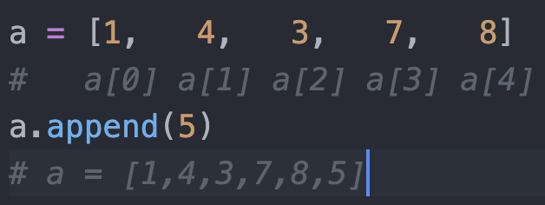
Add data to a list

Slide 9
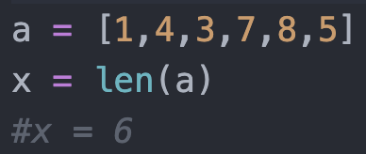
Length of a List
We can check how many elements a list has

Slide 10
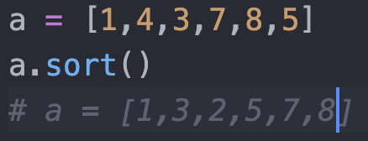
Sort the numbers in a list!

Slide 11
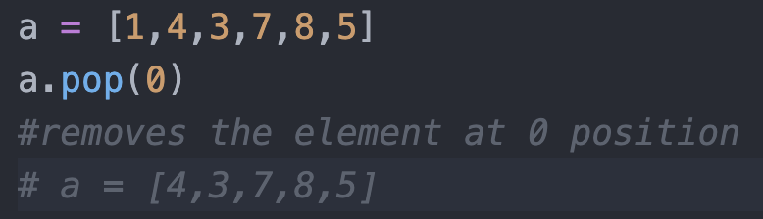
Removing an element from a list

Slide 12
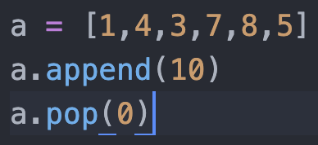
Exercises
len(a)
Changes to a

Slide 13
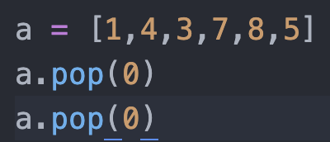
Exercises
len(a)
Changes to a

Slide 14
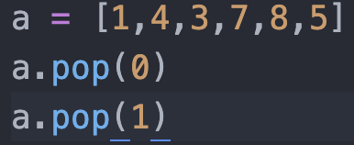
Exercises
len(a)
Changes to a
A = [4,1,3,7,8,5] a.insert(1,1) -> a = [4,3,7,8,5,1]
a.pop(1)

Slide 15
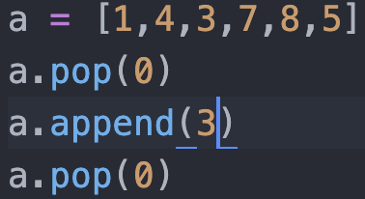
Exercises
len(a)
Changes to a

Slide 16
COLAB TIME!

